Slide 1


PCD & CBN Tooling and Service in Grand Rapids, MI since 1982

Slide 2
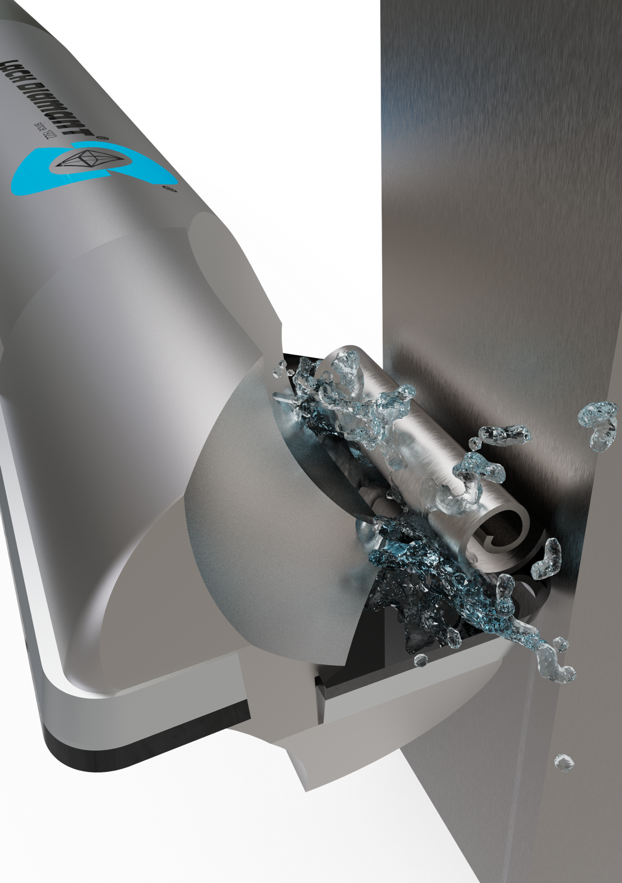


About LACH DIAMOND
Our focus: manufacturing PCD tools (polycrystalline diamond)
Tool portfolio
PCD tools in various industries
Get in touch with us

Slide 3
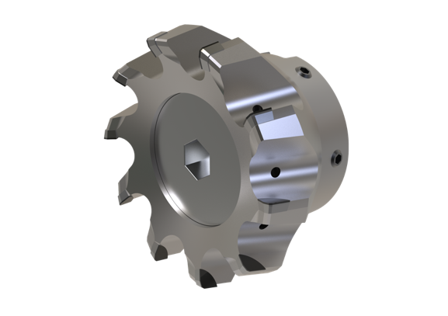
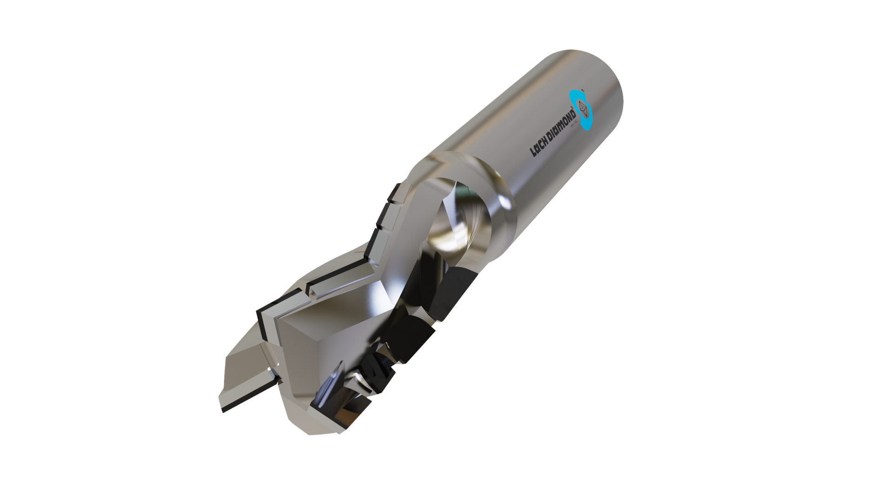
Pioneering PCD, diamond & CBN tooling
– over 100 years of know-how
Economical solutions to advance your performance
High-level cutting operations requiring PCD do not always need new systems.
We recondition your used tooling into highly advanced PCD tools.
Servicing of all PCD
For our tools and for other manufacturers’ products
Production of all new tooling
For non-ferrous metals, wood, and composite materials
Our mission: Being an active partner in your application process
– from start to finish

Slide 4
Product Range
Mills | max. length 370 mm (14.50”) from gage
 | max. Ø (face/bore tooling) 200 mm (8”)
End mills | min. Ø 5 mm (2 flutes), 2 mm (single flute)
Reamers | min. Ø 6 mm (2 flutes)
Tools needing rotary grind | max. length 370 mm (14.50”) from gage
Saw blades | max. Ø 765 mm (30”)
Drills | min. Ø 3 mm (special type applications)
PCD inserts | available in various dimensions

Slide 5
PCD Tool Servicing
Lead times
Regrinds | 1– 3 weeks
Retips | 3 weeks*
Turning/Grooving/Threading/Milling · inserts | 3 – 6 weeks
Milling/Drilling/Reaming/Saw Blades · steel or carbide body | 6 – 8 weeks
Milling/Drilling/Reaming · preform carbide body | 8 weeks
Milling/Drilling/Reaming · integrated shank type | 9 – 11 weeks
* can be as short as 1 day per circumstance

Slide 6
Innovative precision is in our DNA
– over 100 years of know-how
Jakob Lach establishes Lach Diamant as a jewelry cutting and grinding workshop
in Hanau, Germany
Industrial diamonds and diamond tools are added to the portfolio
Horst Lach, together with GE, develops the first PCD tool – true ‘pioneer of diamond tooling’
Lach Diamond, USA, opens as a sales office for Lach Diamant,
servicing the North American market
Lach Diamond starts producing and manufacturing diamond tooling for the processing of wood,
all wood-like materials and plastics for the wood, furniture and flooring industries
1922
1932
1973
1982
1986

Slide 7
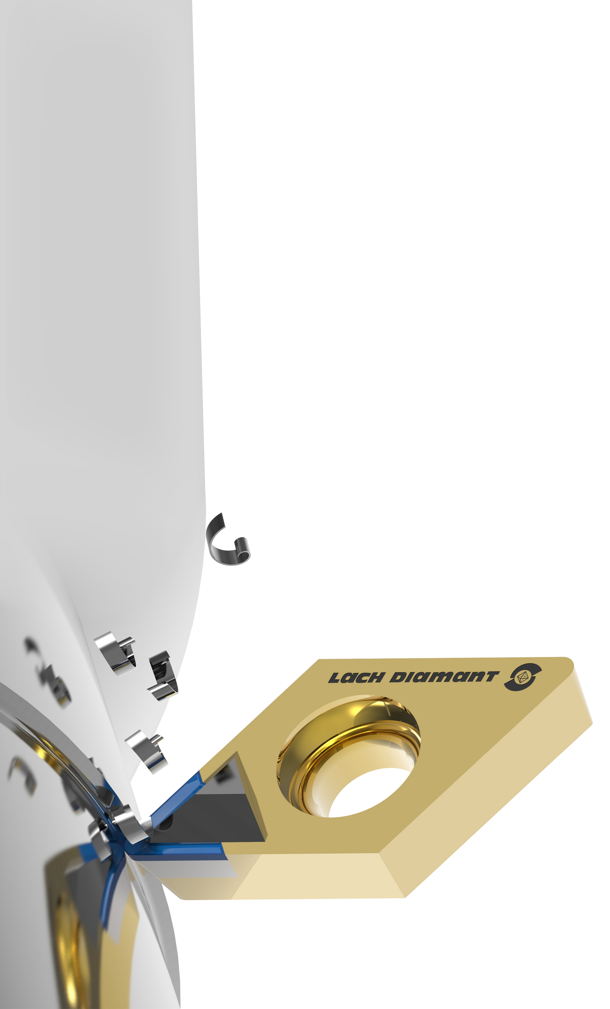
Innovative precision is in our DNA
– over 100 years of know-how
Lach Diamant presents the universal diamond grinding machines EDG for
spark erosion processing of PCD, initially developed for Lach's own production.
These machines are now sold and used all over the world.
Lach Diamond starts manufacturing diamond tooling for the automobile and
accessory industry, aircraft and aerospace industry.
Lach Diamant introduces the patented chip breaker for the
“short-chip-turning” of aluminum.
1987
1999

Slide 8
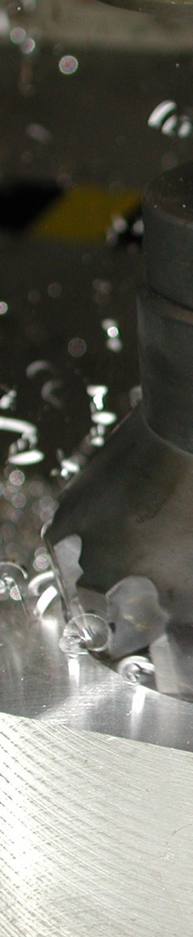
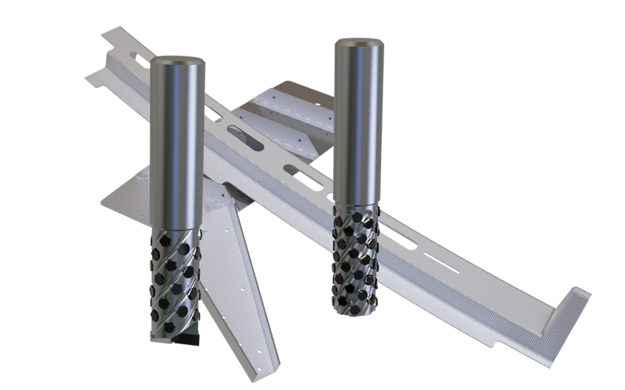

Hessian
Innovation
Prize
2004
Innovative precision is in our DNA
– over 100 years of know-how
The monoblock diamond milling cutter »dia-compact« wins the Hessian Innovation prize
for high-speed machining (HSM) of aluminum and plastics
The PCD end mill »multiple cut« wins the AIRTEC Award for use in
unstable elements of fiber reinforced materials
Lach Diamond begins expanding marketplace footprint for
various special non-ferrous alloys
Lach Diamond celebrates 40 years of providing our service to help industries
grow and innovate. Thankful for our customers and their input that continues to be
a part of our innovational growth.
2004
2006
2010
2022

Slide 9
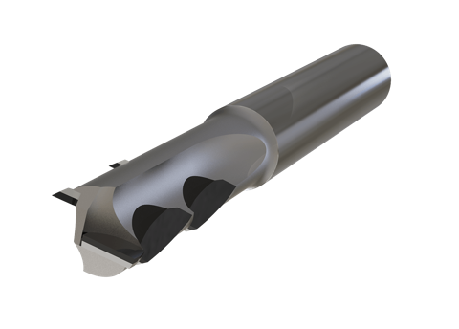
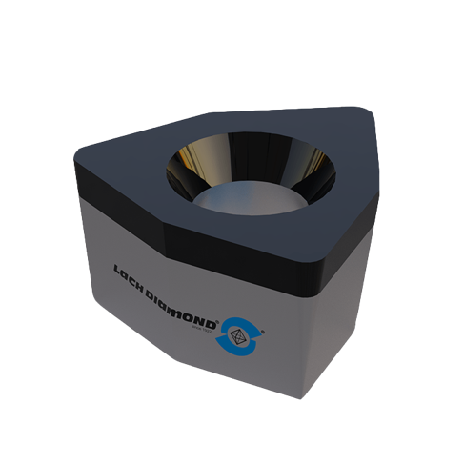
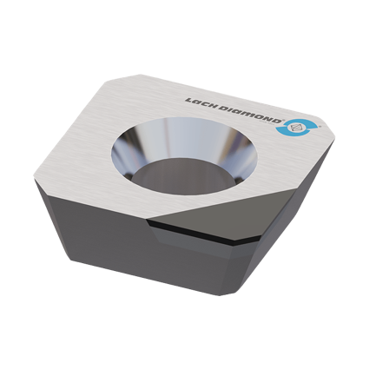
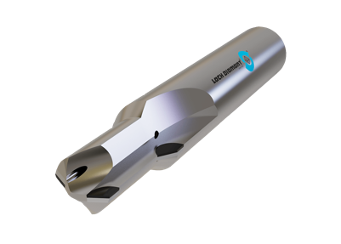
What is PCD?
PCD stands for PolyCrystalline Diamond
  synthetic diamond produced by compressing diamond powder under high pressure and temperature
  exceptional hardness, wear resistance, and thermal conductivity
PCD is excellent for cutting, milling and turning
  non-ferrous metals, wood, foams and various composite materials
  ceramic, hi-silicon, glass, or abrasive materials
There are several grades of PCD from several manufacturers.
Each has their own usage and special applications.

Slide 10
PCD grade examples
< .002 – Finishing Grade: <2 micron in size.
A standard finishing application diamond in most all materials. Even small grain versions are available.
.010 – General Purpose Grade: <10 micron in size.
A standard use application diamond in most all materials.
> .025 – Rough service / abrasive applications: This is a 25 micron size.
A standard product in high silicon aluminum and also rough turning and milling applications.
Bi–Modal/ Multi-Modal - a special product that is a mix of different diamond size grains.
This allows the best compromise of finish for production and wear resistance in manufacturing.
It is not used in all applications, only special applications.
We are happy to recommend the ideal PCD grade for your application

Slide 11
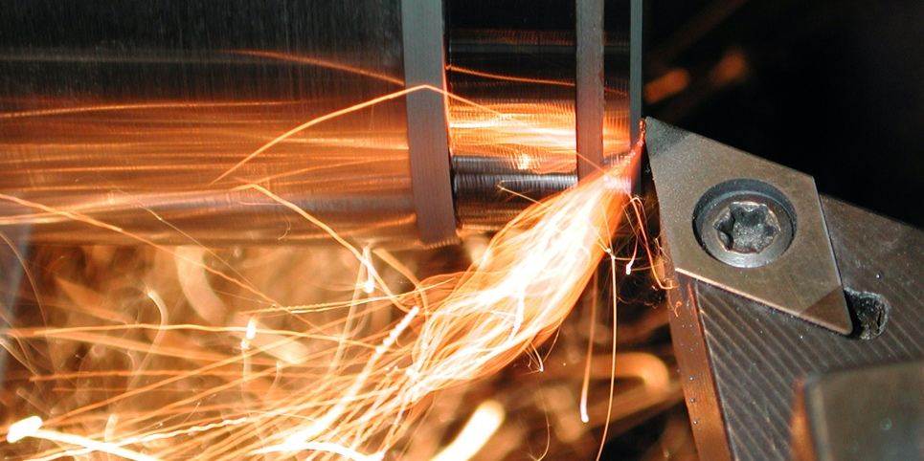
What is CBN?
CBN stands for Cubic Boron Nitride
  synthetic crystalline substance consisting of boron and nitrogen and structurally similar to diamond
CBN is suited for cutting, milling and turning
  hardened and tempered steel
  cast iron
  cemented carbides and other difficult to machine materials

Slide 12
for which materials?

Slide 13
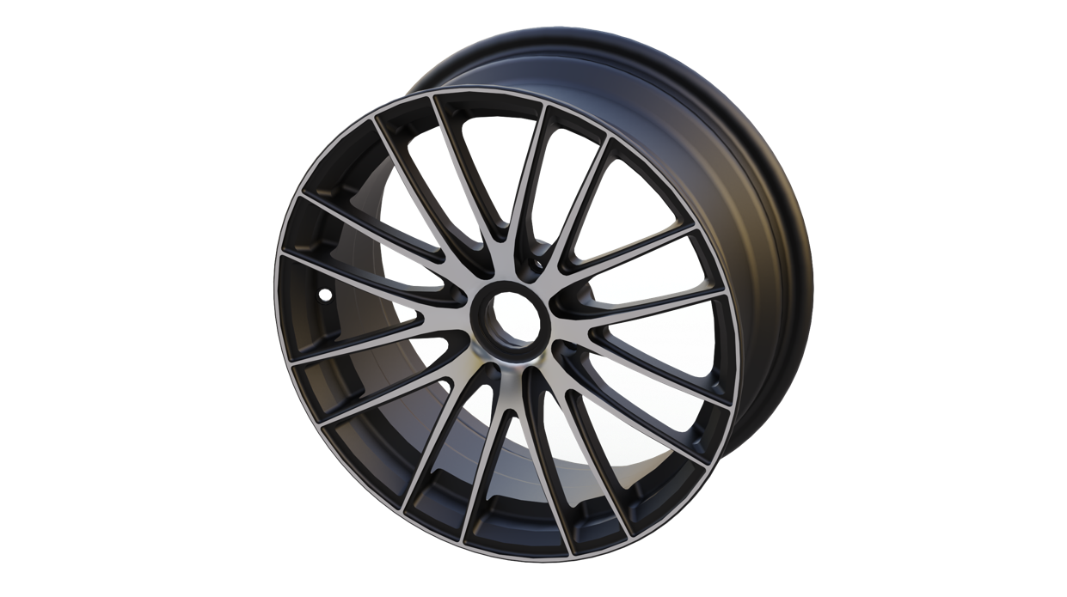

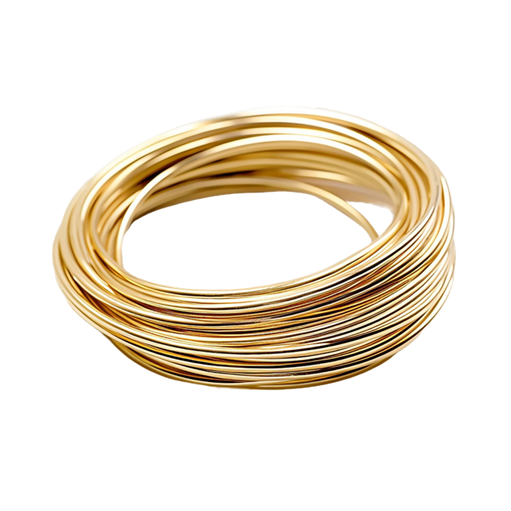
Materials for machining with PCD
Non-ferrous metals
Aluminum
Brass
Bronze
Copper
Magnesium
The significance of Silicon (Si) content in aluminum:
The higher the silicon content in aluminum, the more abrasive it is and, therefore, reduces tool life.

Slide 14
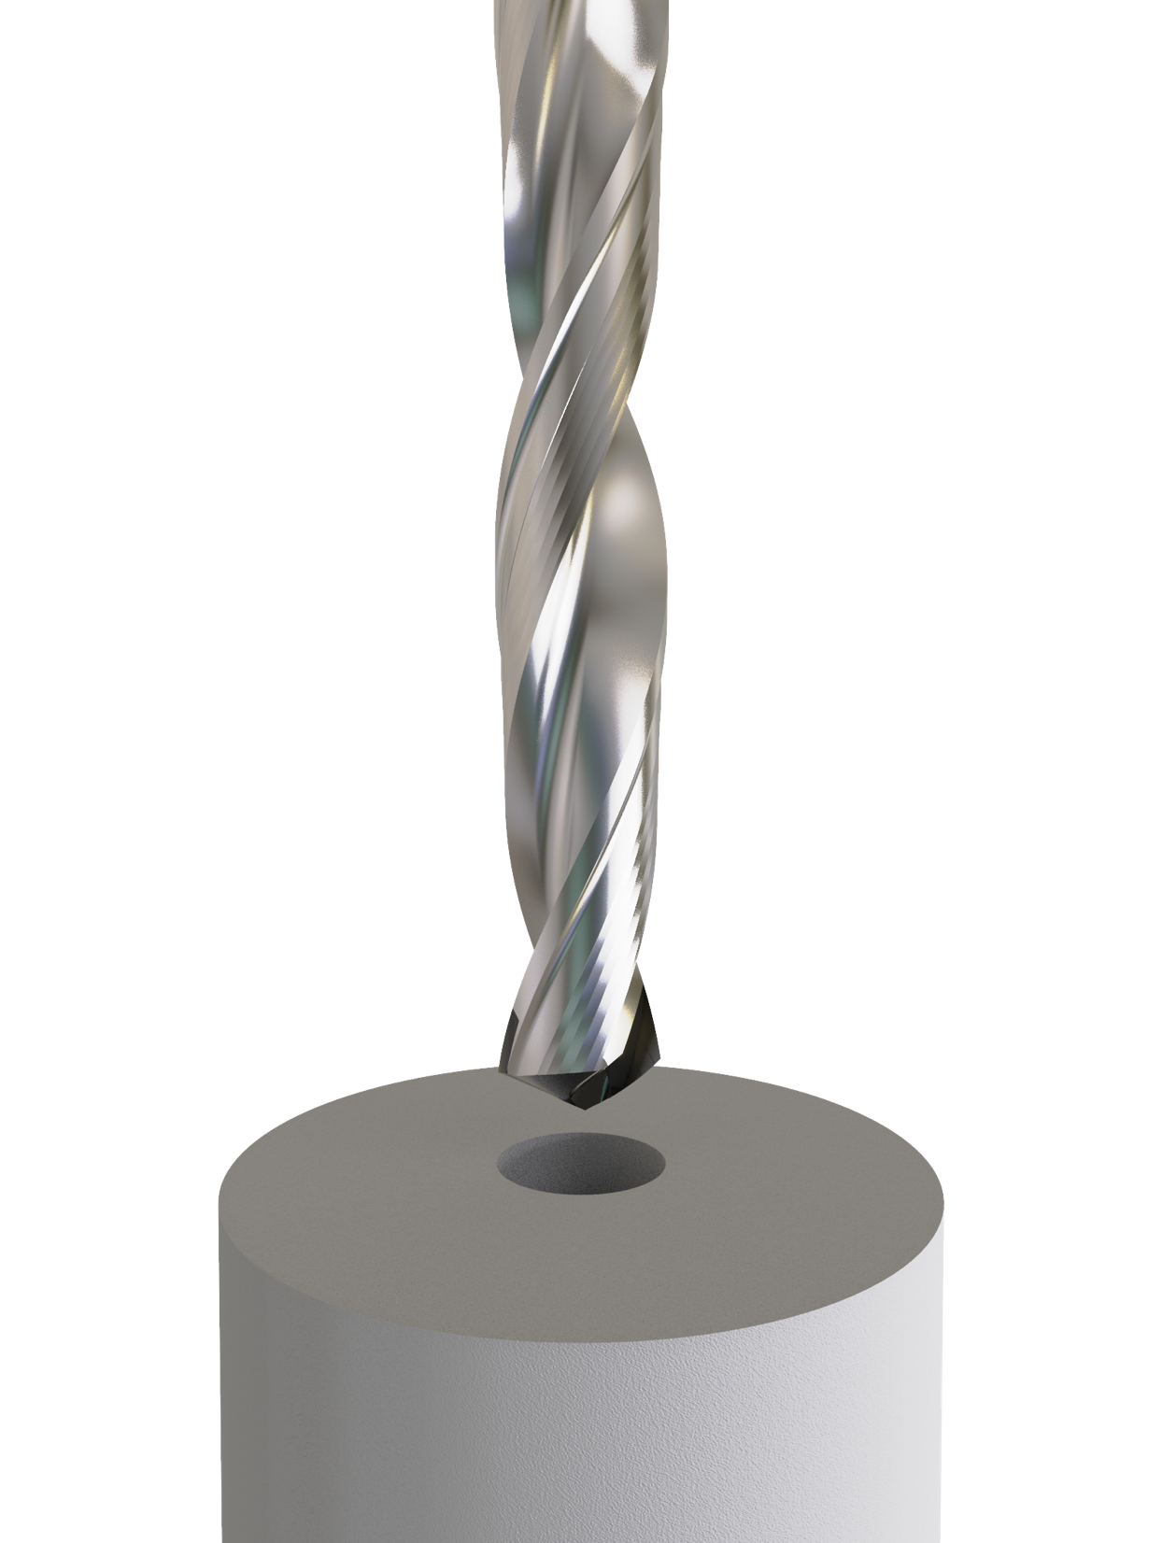
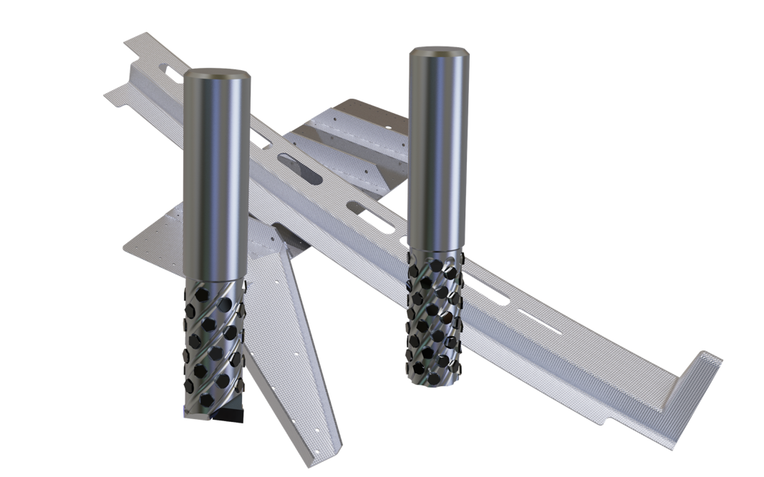
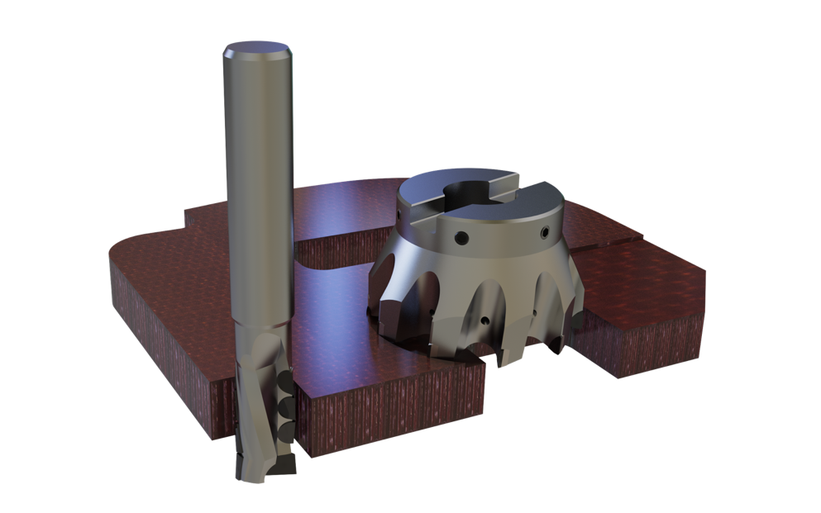
Materials for machining with PCD
Composites
Carbon fiber (CFRP)
Reinforced Fiberglass (GRFP), also with injected resin
Graphite
Green Ceramic & Green Carbide
Fiberglass (ex: G10)
Kevlar
PCD tipped drills – at the center point – are suited to drill in solid composite, because there is less cutting pressure at the zero point than in non-ferrous metals.

Slide 15
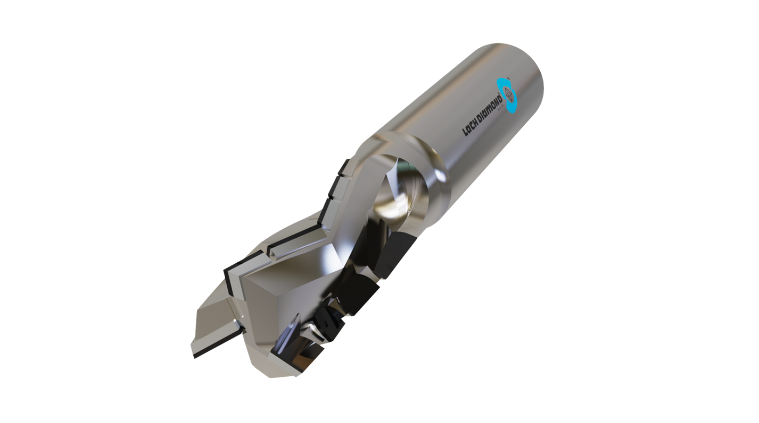
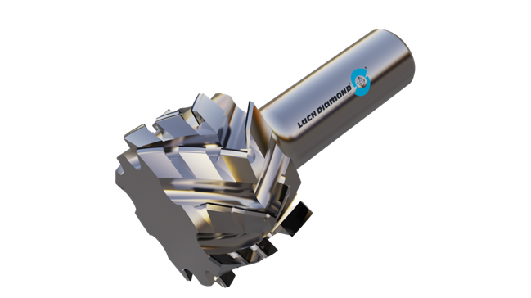
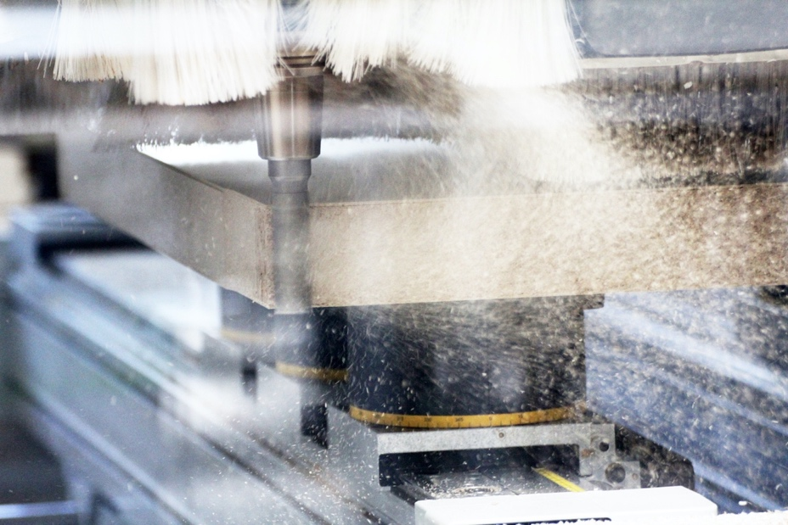
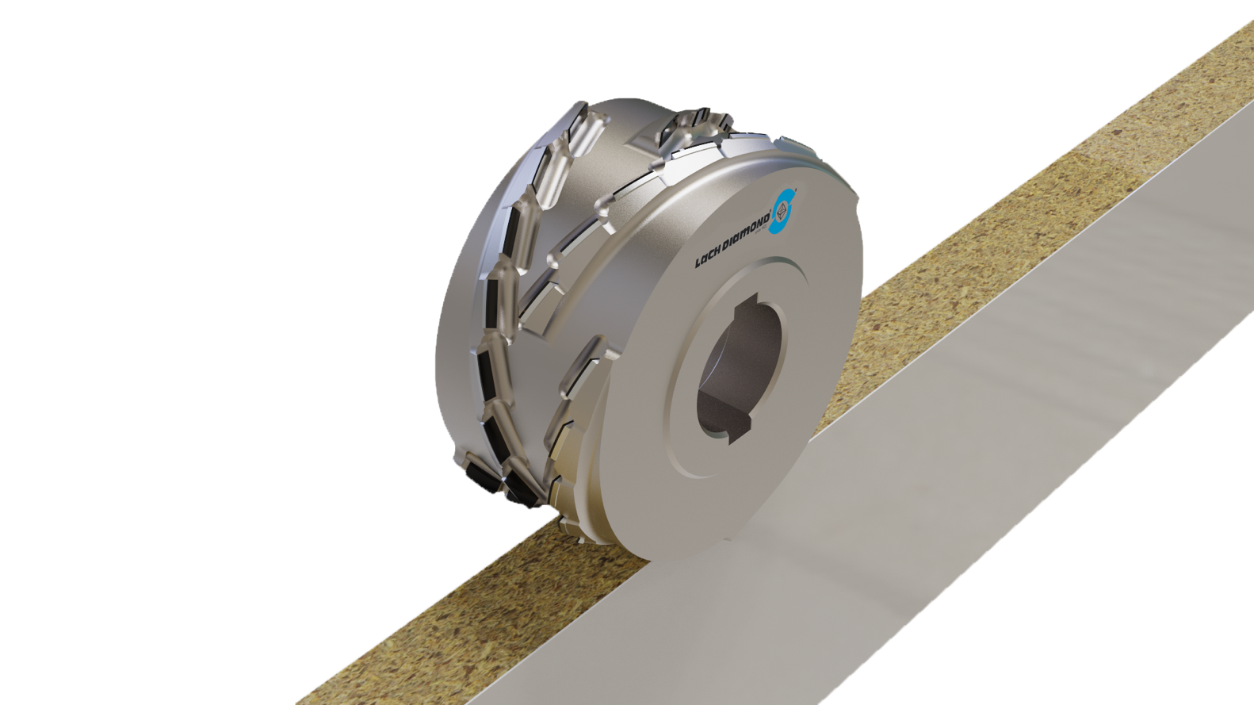
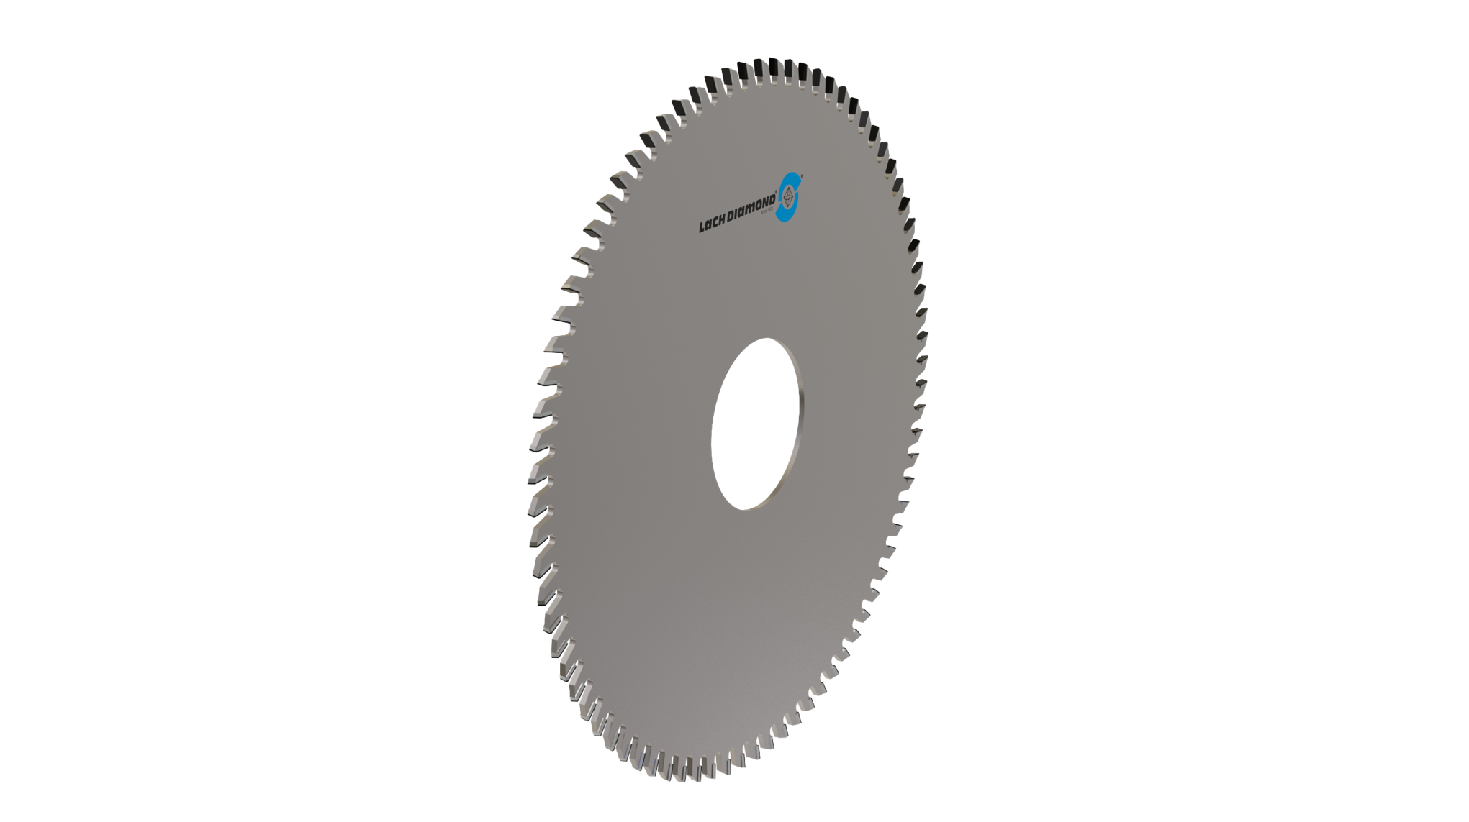
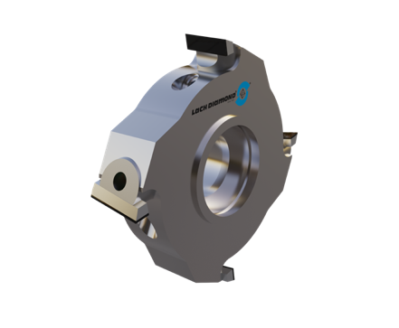
Materials for machining with PCD
Wood
Particle board
High pressure laminate (HPL)
Medium-density fiberboard (MDF)
High-density fiberboard (HDF)
Honeycomb core wood panels

Slide 16
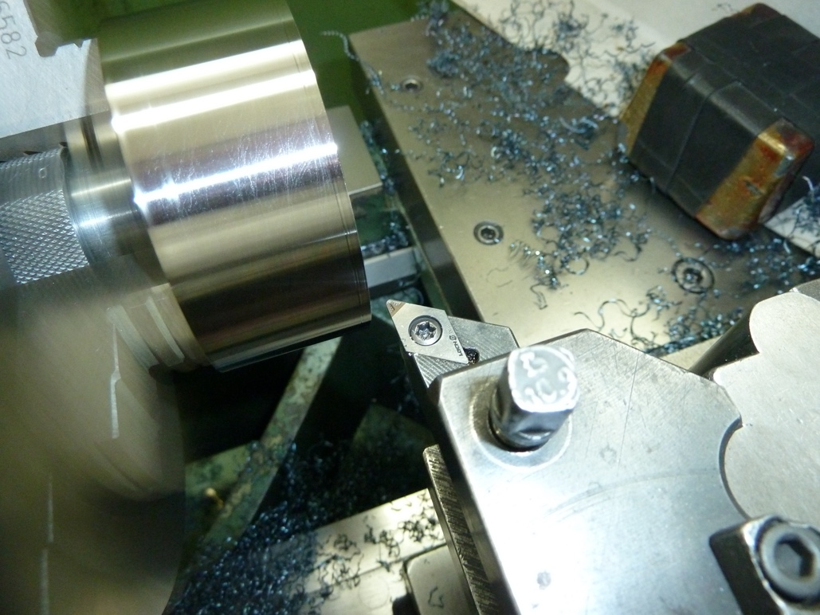
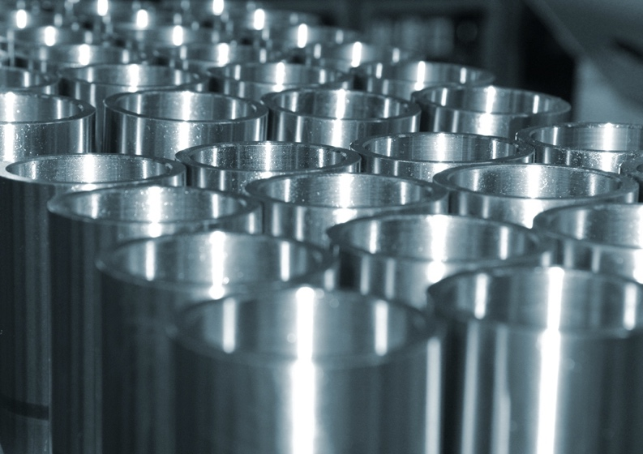
Materials for machining with CBN
Ferrous metals
Cemented carbide
Hardened steel
Cast iron

Slide 17
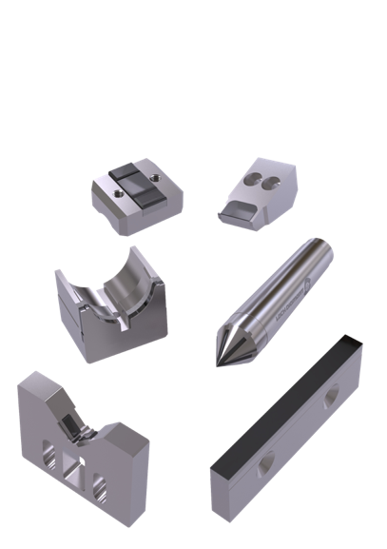
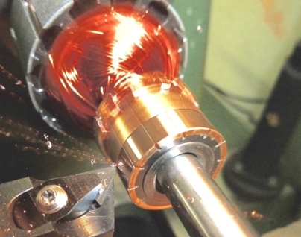
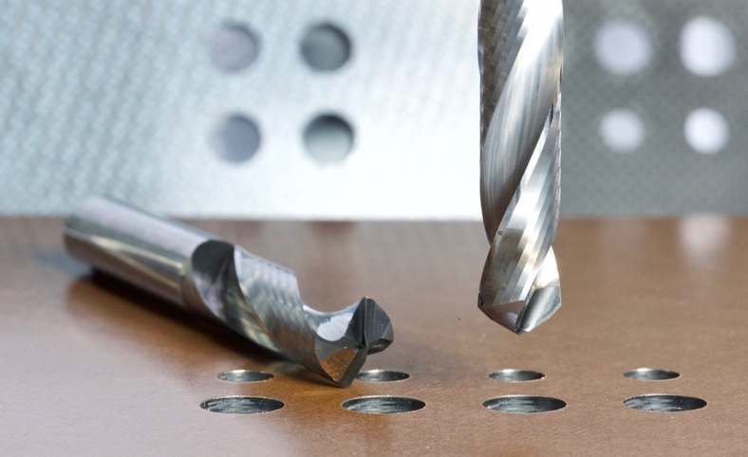
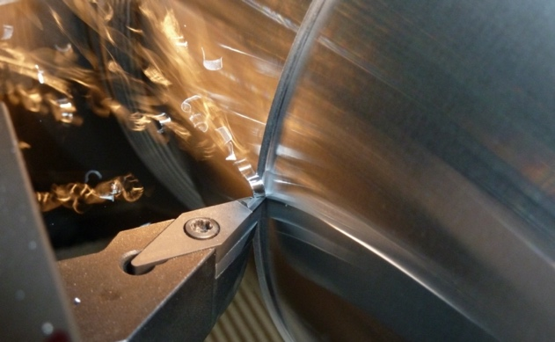
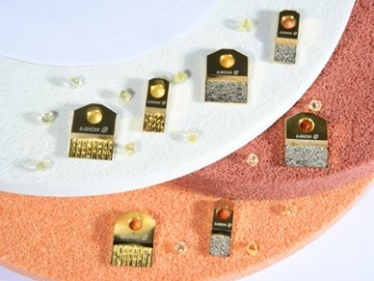
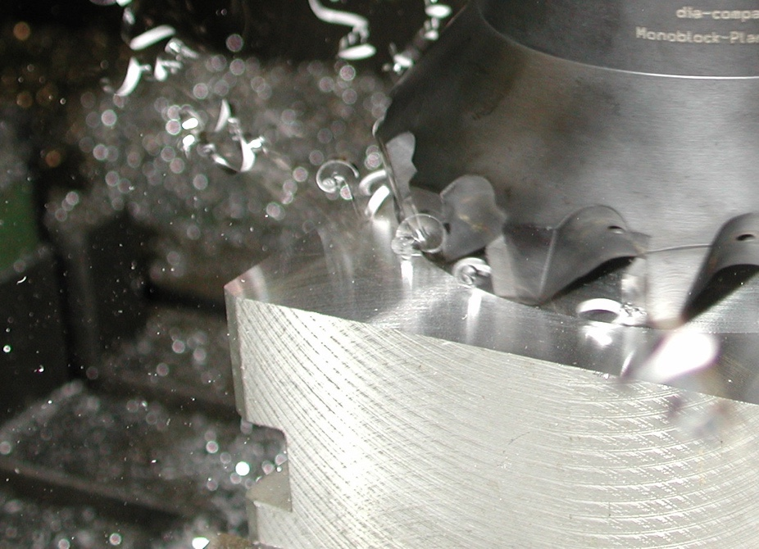
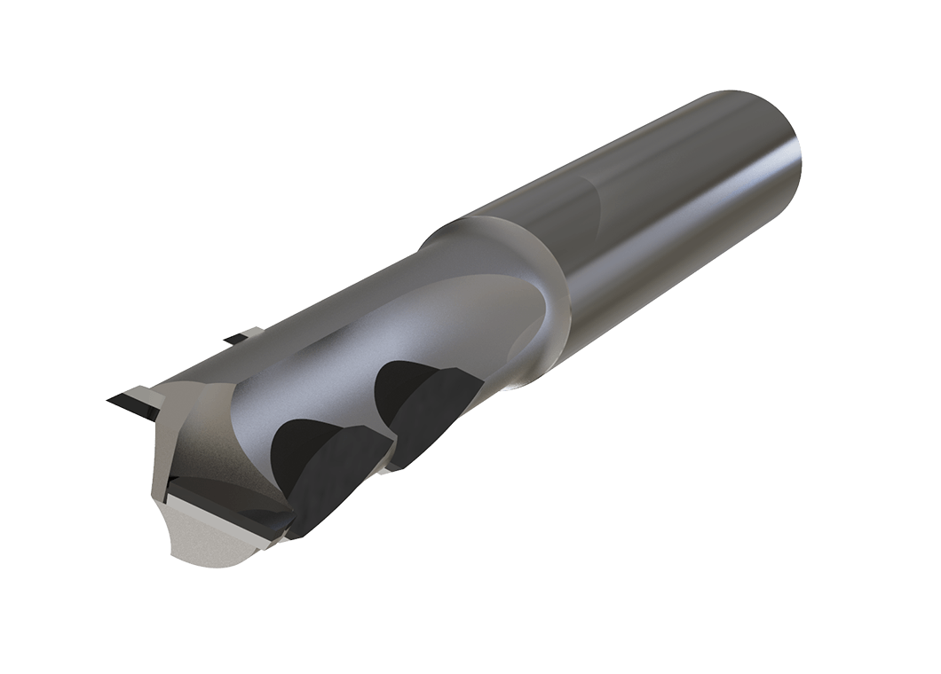
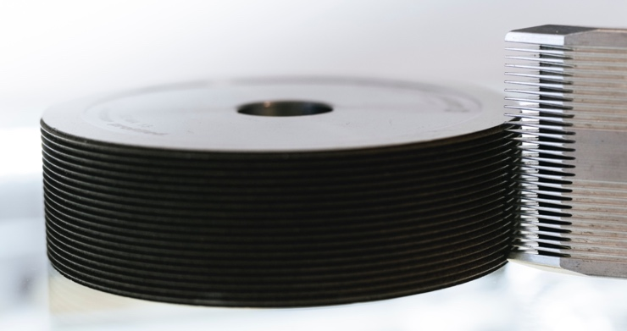
Portfolio

Slide 18
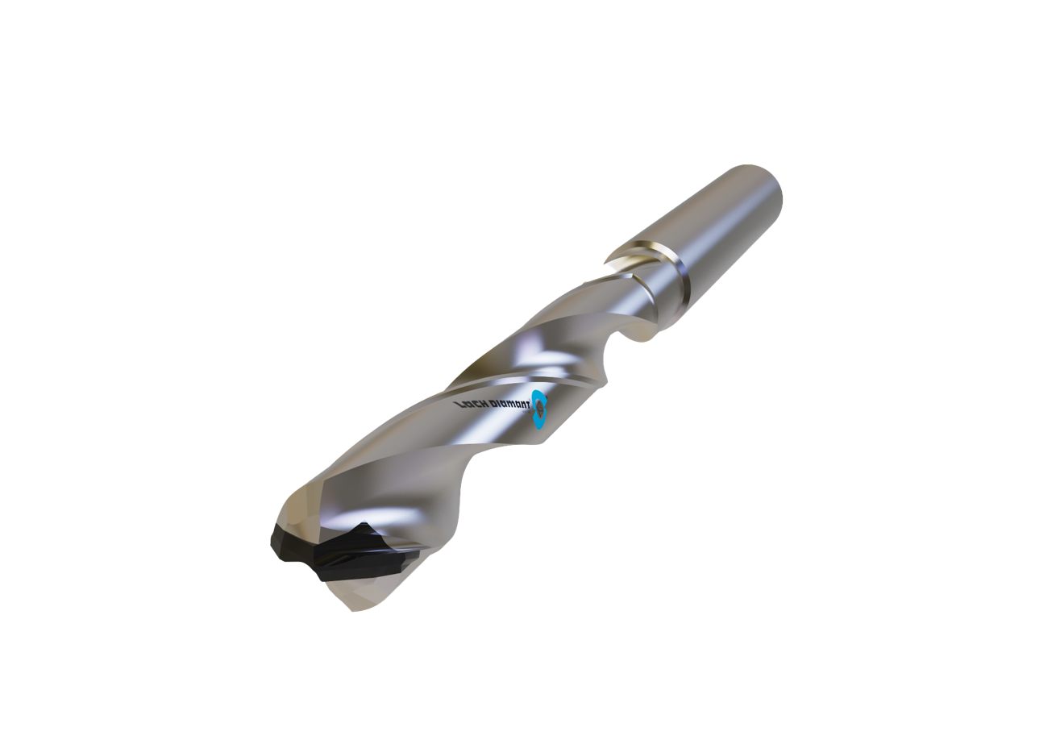
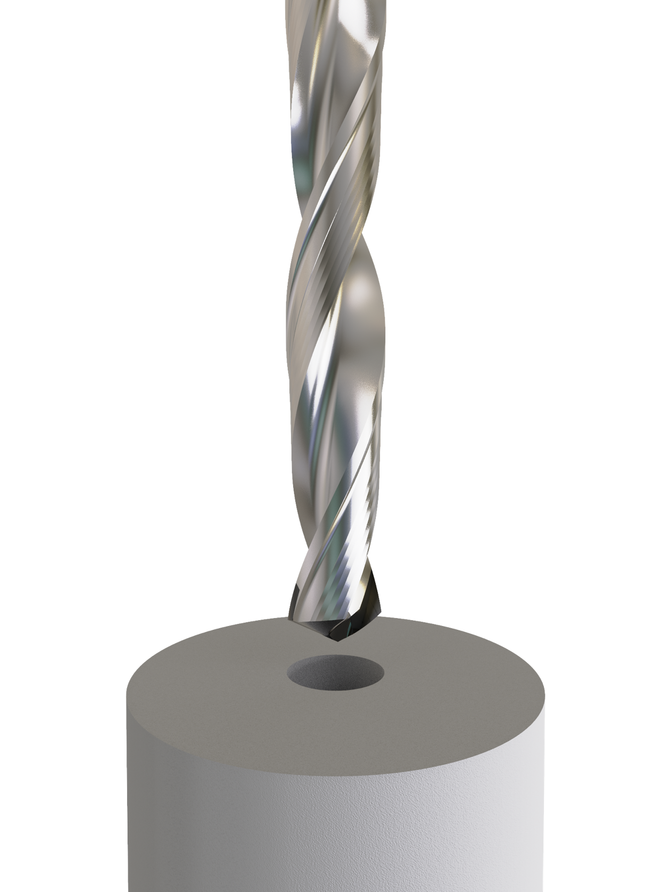
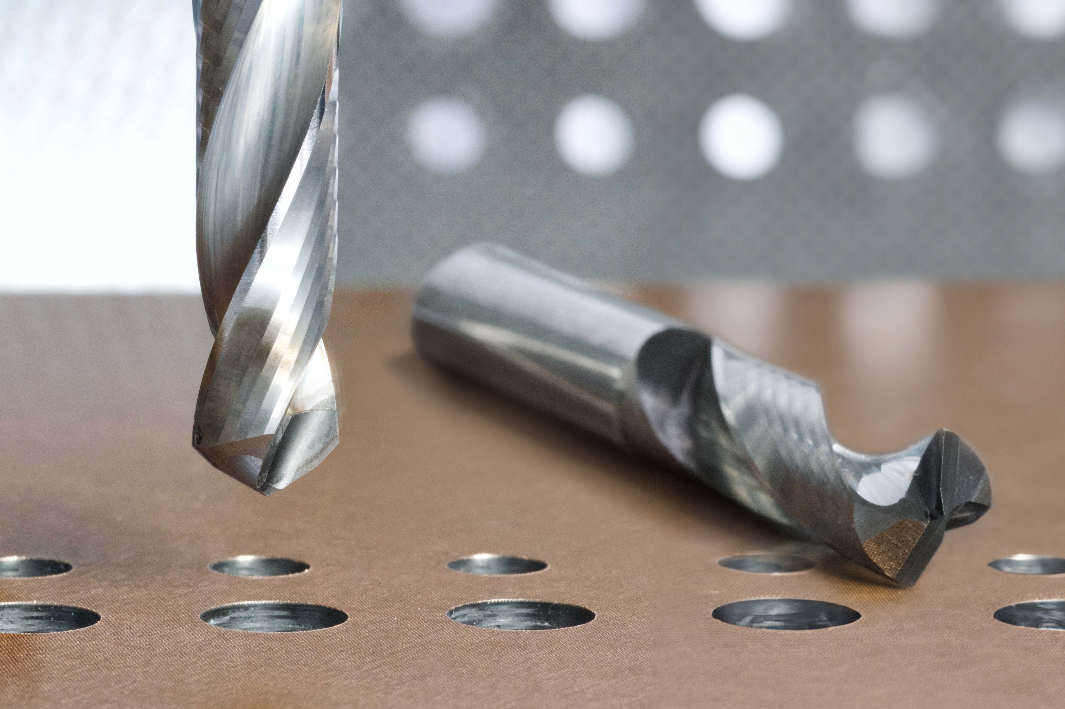
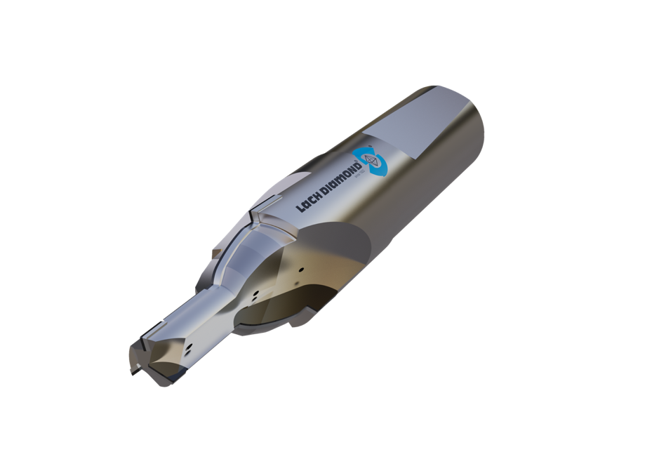
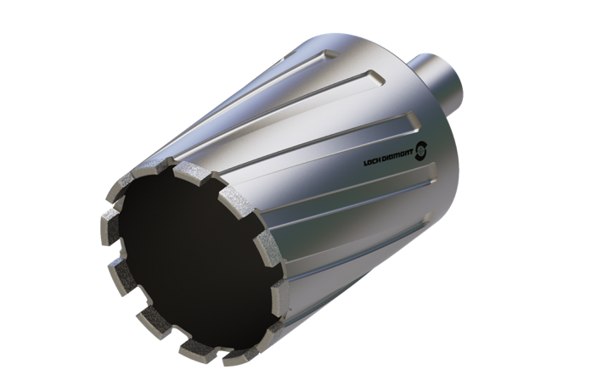
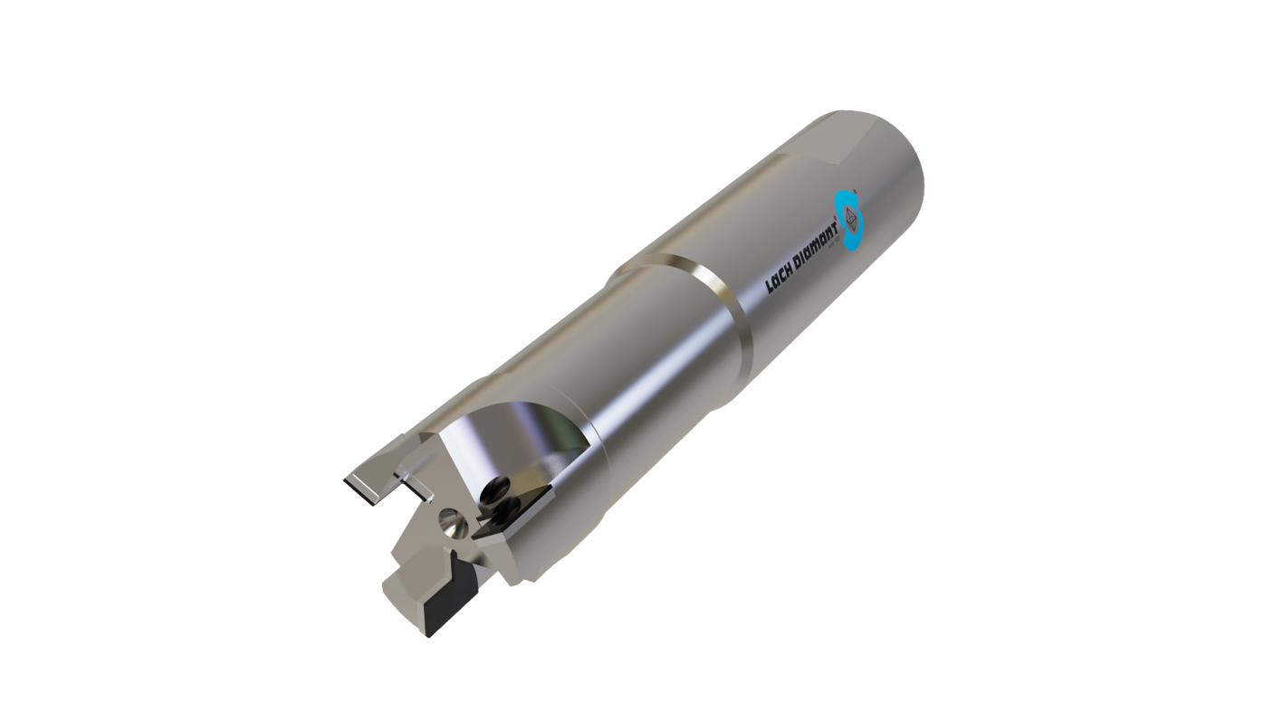
PCD drilling tools
Spiral drills
Step drills
Hollow drills
Drills with internal exhaustion (pat.)
Drilling and reaming in one step
No reworking/refinishing required
Resharpenable
Design according to your requirements

Slide 19
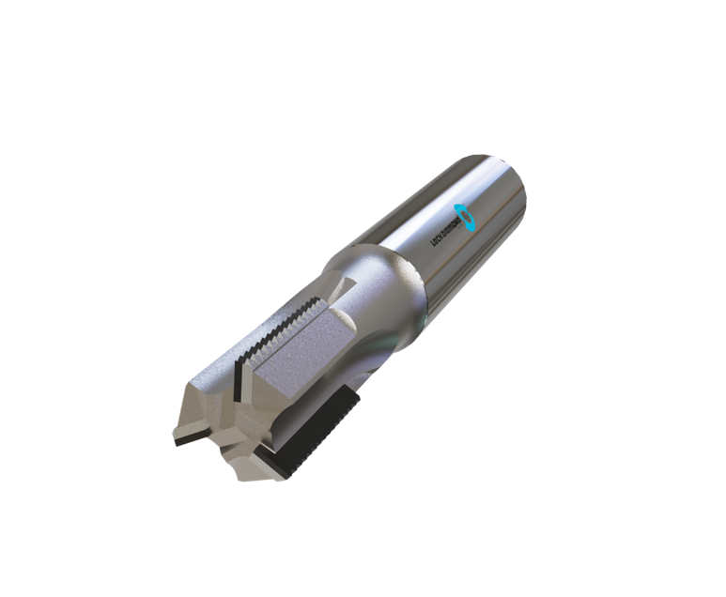

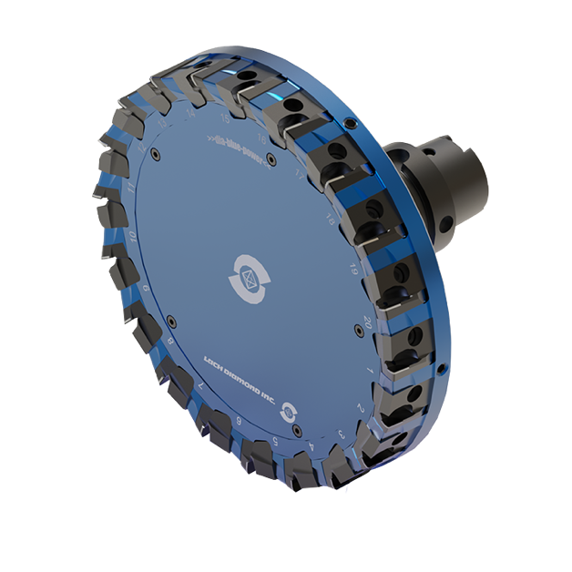
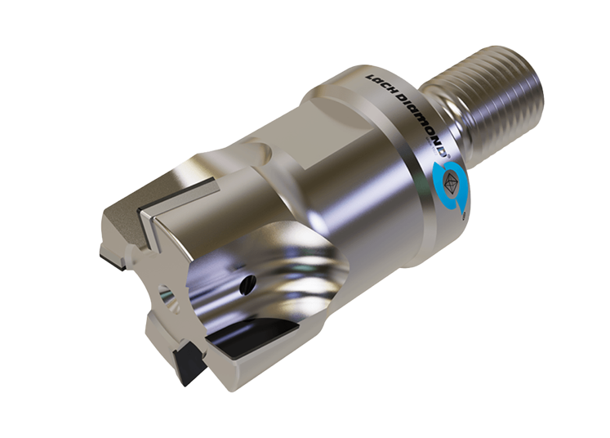
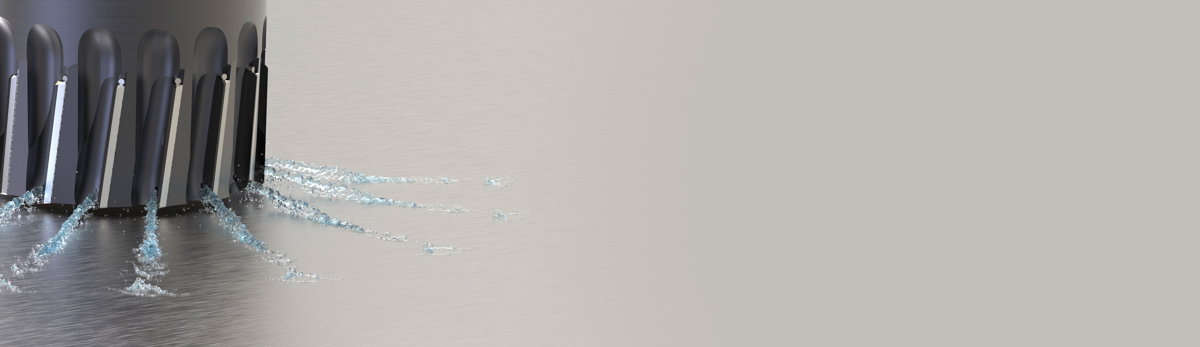
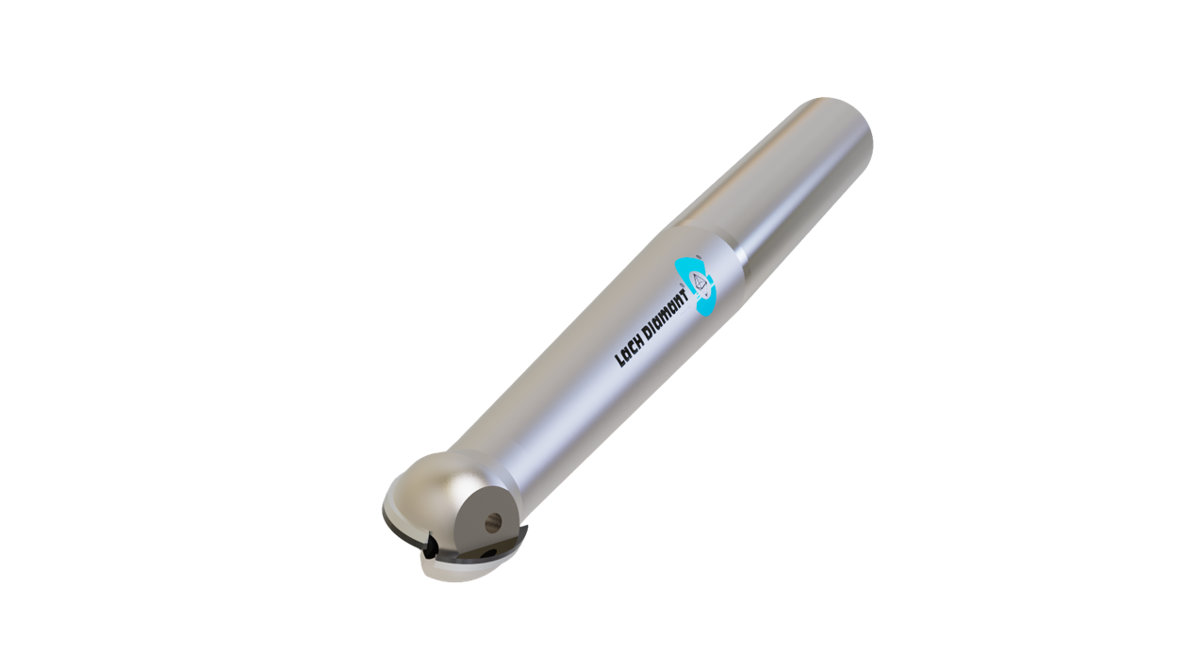
PCD milling tools
Monoblock milling cutters
Cartridge milling cutters
Copy milling cutters
End mills
Innovation »Cool Injection Plus«
– With this innovation the coolant is directed through the open cutting face of the PCD edge: directly where the chip being generated.
CBN optional
for some tools
– do not hesitate
to ask!

Slide 20
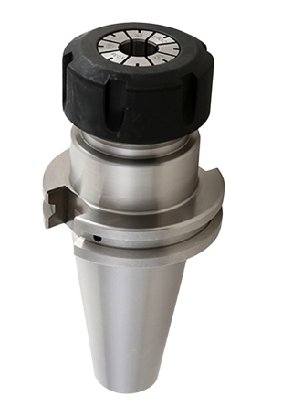
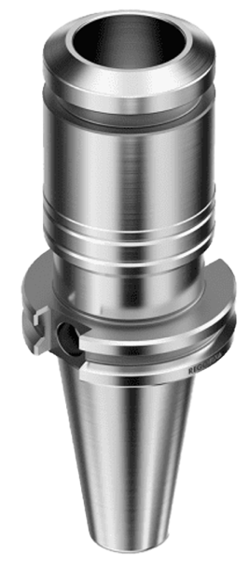
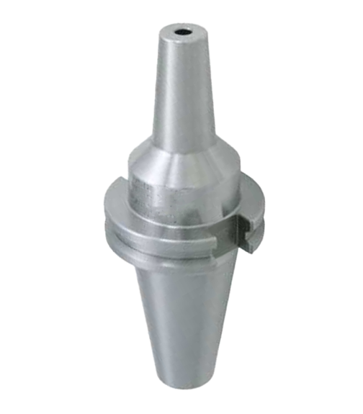
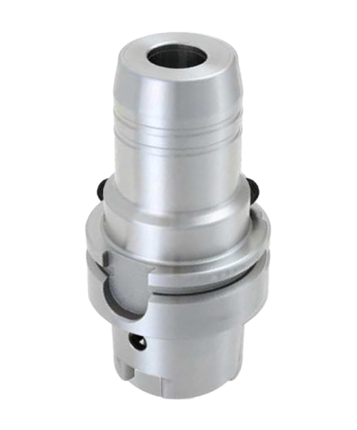
Holder types
Mechanical
“power grip”
chuck
Collet type
holder
Shrink fit
holder
Hydrolic
chuck

Slide 21
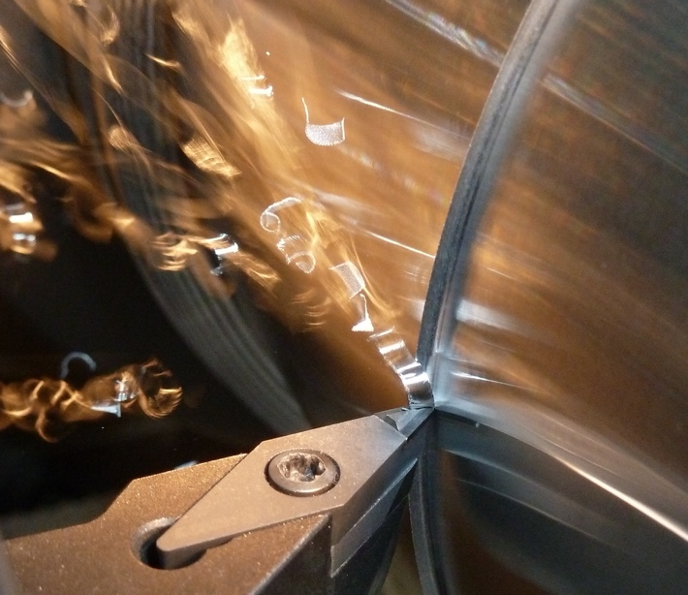
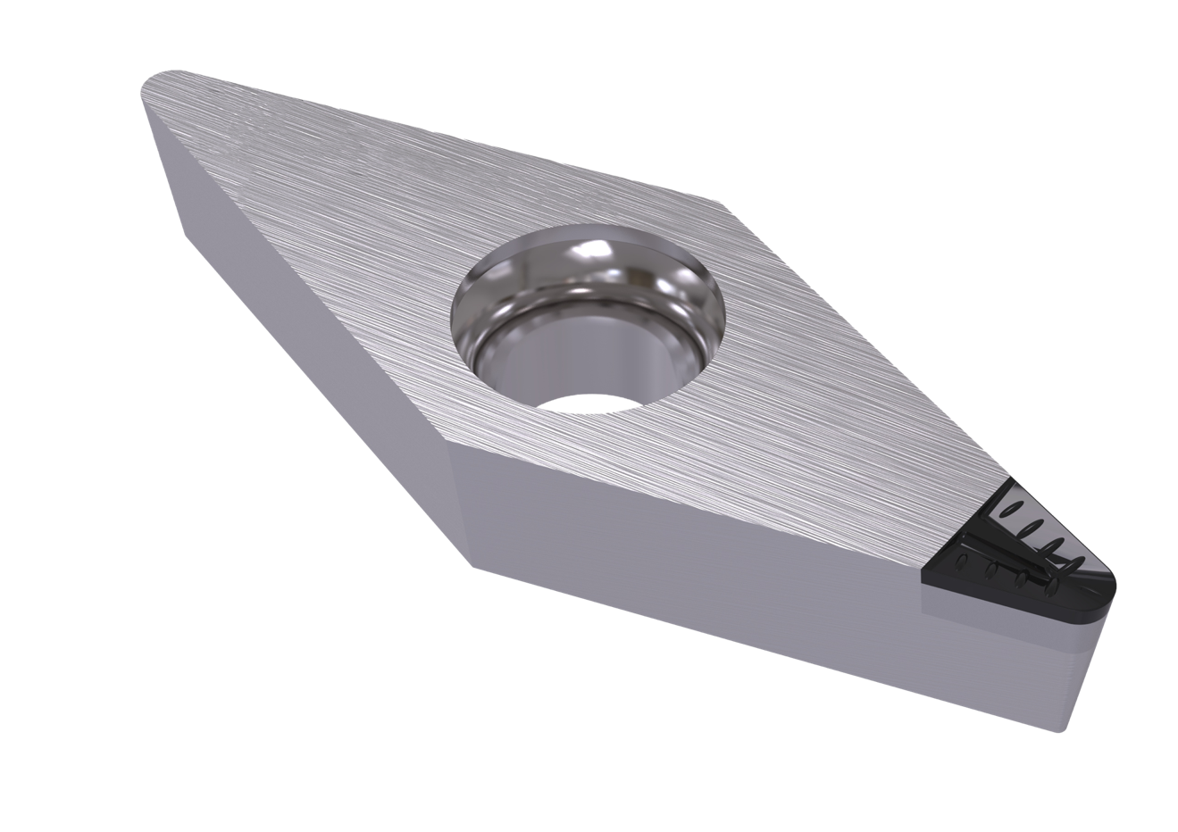
PCD chip breaker inserts for turning
»IC-plus« chip breaker (pat.)
– insert with active chip breaker and stable cutting edge for thick, stable elements and turning operations both interrupted cut and continuous turning
Lach XCO chip breaker
– insert with custom-tailored chip guide step and positive cut for especially thin and unstable elements, best for continuous turning

Slide 22
PCD & CBN cutting inserts for turning
»CBN-DUO-power«
– insert for turning hardened steels with highest surface qualities of e.g. Ra 0,1 µm,
CBN-tipped on both ends
Cutting inserts most suitable for your application
– we offer various inserts tipped with PCD or CBN for high-precision turning

Slide 23
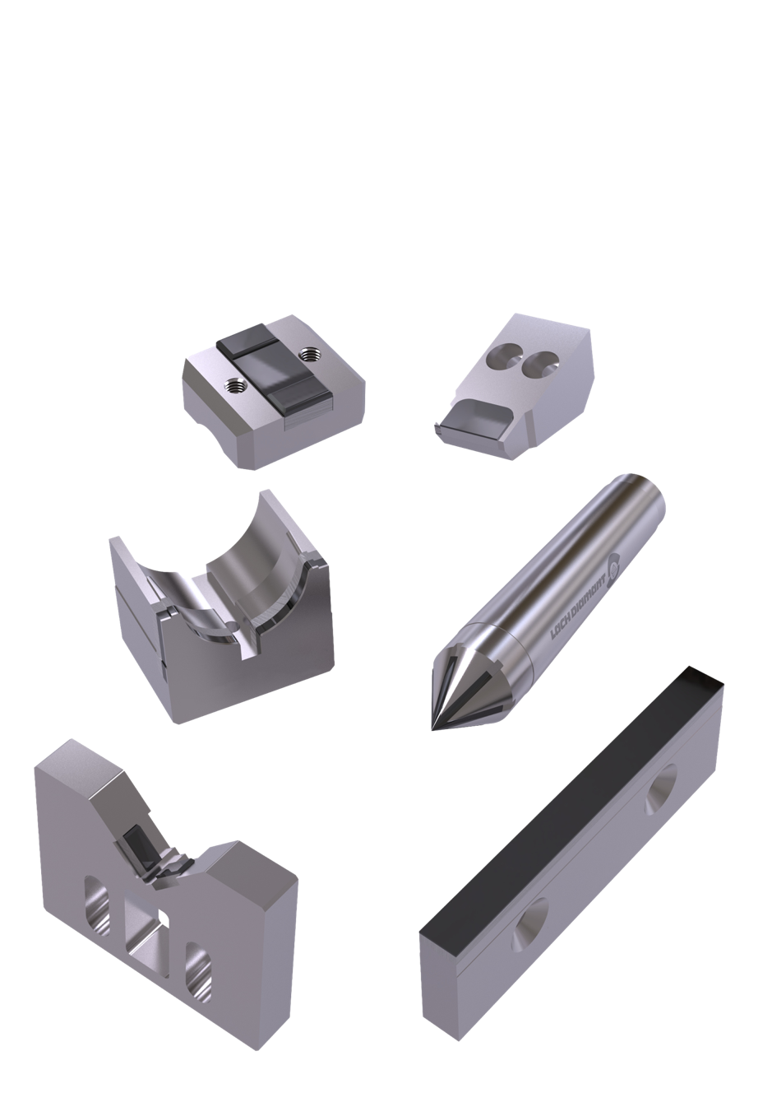
PCD and diamond wear protection
Steady rest blocks
Work rest blades
Prisms
Center points
Bearing shells

Slide 24
Wear parts
Turning
Drilling
In summary of our products
Dressing
Grinding
Milling

Slide 25









for various industries

Slide 26






Industries machining with PCD tools
Automotive & Industrial engines
Brake & Wheel related products
Chassis components
Engine & Transmission
related products

Slide 27




Industries machining with PCD tools
Aerospace

Slide 28


Industries machining with PCD tools
Electric motor manufacturing
PCD inserts for corner radius- and peel turning
(e.g. commutator turning)
PCD-tipped stripping knives

Slide 29


Industries machining with PCD tools
Electronics / Printed circuit boards (PCB)
PCD and carbide tools for production and depaneling of PCB
Edge bevelling
End milling
Bevelling
Cutting, scoring, sawing etc.
IMS
Aluminum
Copper
Multilayer
Rigid-flex
For various PCB materials

Slide 30




Industries machining with PCD tools
Wind Power / Rotorblade root end processing

Slide 31



Industries machining with PCD tools
Gravure printing
high-precision cylinder processing
cutting tools for
  CFM machines
  Polishmaster milling machines
  Acigraf SuperPerfast machines

Slide 32
Industries machining with PCD tools
Woodworking
Panel sizing
Through-feed processing
Stationary processing
Jointing, edge trimming & nesting cutters
Universal & profile routerbits
Drills
Hoggers
Sawblades
Maximum tool lives and extremely stable
cutting edges due to adapted PCD qualities.

Slide 33




Industries machining with PCD tools
Optics
Eye glass machining tools
for the polycarbonate lens

Slide 34
Automotive
Electronics
Electric motor manufacturing
In summary of industries
Wind power
Gravure printing
Woodworking

Slide 35
Get in touch with us
Amber Clisso, Sales Assistant aclisso@lachdiamond.com
She has been with Lach Diamond for 24 years. Works directly with salesmen, assists with quoting and handles all orders and processing.
Randy Prafke, Manager of Operations rprafke@lachdiamond.com
He has been with Lach Diamond for 39 years. Oversees all production, works with the Lach Diamond sales team, and advises on engineering.
P. J. Agnew, National Sales Manager pagnew@lachdiamond.com
He has been in the industrial tooling industry for 25 years – 15 years with Lach Diamond. Oversees sales with team member, distributors, manufacturer’s reps, and end-users.
Jim Johnson, Sales (woodworking industry) jjohnson@lachdiamond.com
He has been with Lach Diamond for 35 years. Specialty in woodworking sales & related aspects, quotes, and provides support/technical assistance to reps and end users.
Mike Kruisenga, Sales (metal/woodworking industry) mkruisenga@lachdiamond.com
Our newest employee with an industrial background in manufacturing and sheet metal. Assists in tooling applications, quotes, technical inquires and service to distributors and end users.
Annabelle Lach, Vice President alach@lachdiamond.com
Together with her father Horst Lach, she continues Lach’s commitment to innovation and long-term growth as a family business.

Slide 36


Explore our website
www.lachdiamond.com

Slide 37

Thank you!

